Slide 1

BANK ENTERPRISE NETWORK MODEL
ON CISCO PACKET TRACER
Page | 01

Slide 2
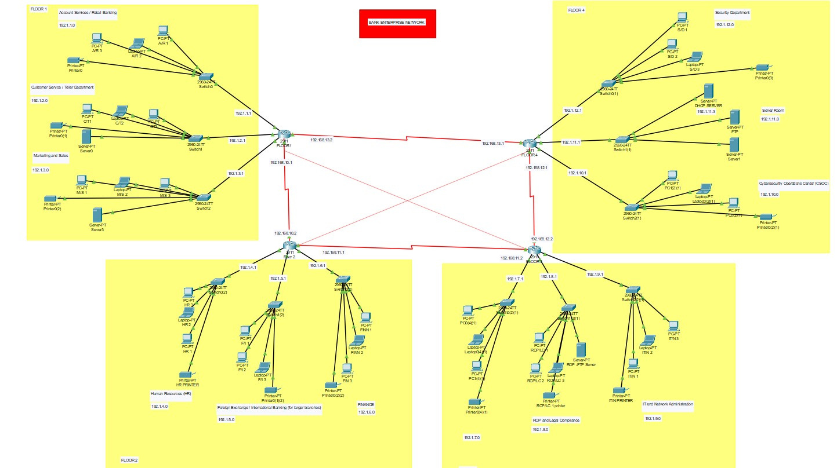
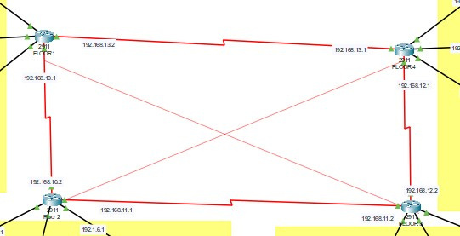
PROJECT
INTRODUCTION
This project, titled "Bank Enterprise Network on Cisco Packet Tracer," is developed as a semester project for the Data Communication and Networking (DCN) course. The network is designed to simulate a large-scale banking environment and includes connectivity and communication between 12 distinct departments, each representing a functional unit within a real-world banking organization.
To ensure efficient data forwarding and network scalability, dynamic routing protocols have been configured to interconnect all departmental networks. These protocols enable automatic route recalculation in response to topology changes, ensuring optimal path selection, improved convergence, and streamlined network management.

Slide 4
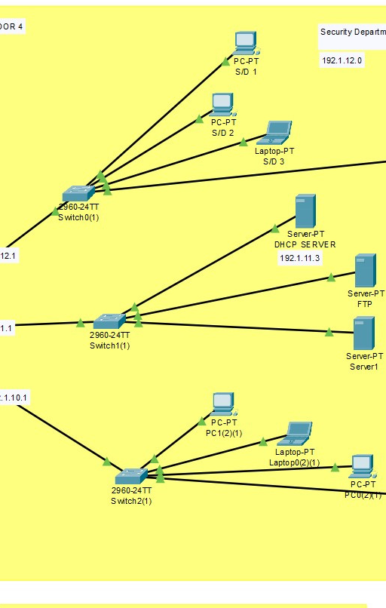
I
BANK ENTERPRISE – FLOOR-WISE DEPARTMENT DISTRIBUTION
The bank enterprise is structured across 4 floors, with 3 departments on each floor, simulating a multi-layered enterprise network topology.
Floor 1:
Account Services / Retail Banking
Customer Service / Teller Department
Marketing and Sales
Floor 2:
Human Resources (HR)
Foreign Exchange / International Banking
Finance
01
02
Floor 3:
Risk Operations (ROP) and Legal Compliance
IT and Network Administration
[One slot left blank if needed, or noted as reserved]
Floor 4:
Security Department
Server Room
Cybersecurity Operations Center (CSOC)
03
04
www.reallygreatsite.com
Page | 05

Slide 5
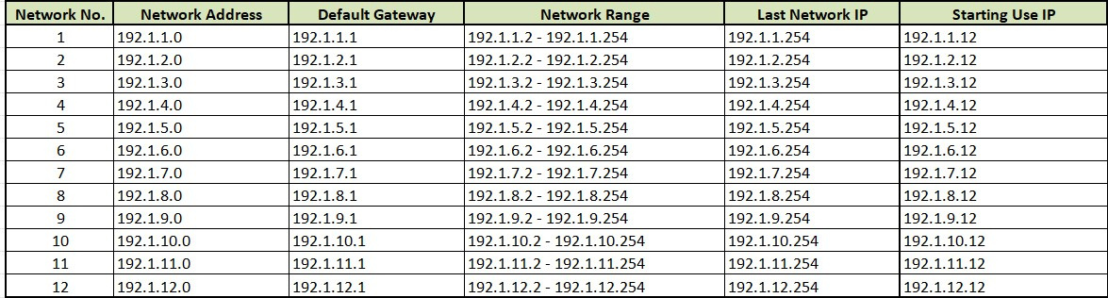
To ensure structured communication across the bank enterprise network, 12 separate networks have been designed — each assigned to a specific department.
Each network is based on a /24 subnet (e.g., 192.1.X.0/24), allowing up to 254 usable host IPs per department.
A unique Network Address, Default Gateway, and IP Range is assigned to each department to maintain logical segmentation.
Default Gateway (e.g., 192.1.1.1) is configured on Layer 3 devices to enable inter-VLAN routing and external communication.
The usable IP range starts from .2 to .254, with a reserved starting IP for hosts (e.g., .12) to maintain consistency in configuration.
This structured IP plan improves network manageability, troubleshooting, and scalability.
🛰️ SMART IP ALLOCATION STRATEGY ACROSS BANK DEPARTMENTS
Page | 07

Slide 6
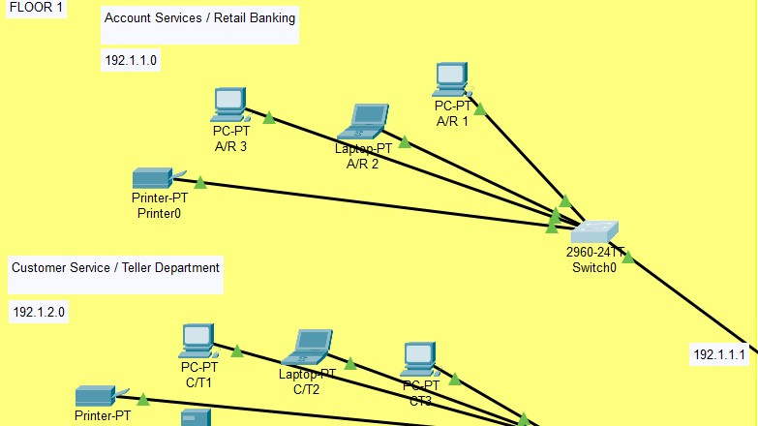
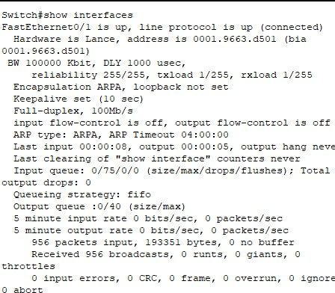
FLOOR 1 NETWORK OVERVIEW
Hosts the following departments:
Account Services
Customer Service / Teller Department
Marketing and Sales
Each department includes:
LAN-connected PCs and network printers
Connected through a Layer 2 switch for intra-department communication
All devices receive IP addresses via DHCP,
DHCP server is located on Floor 4 (Server Room)
Server Access:
Customer Service and Marketing departments host local departmental database servers
Account Services accesses the main centralized database server
Credential-based authentication is required for all users to access servers and shared resources
Assigned subnets:
192.1.1.0/24 – Account Services
192.1.2.0/24 – Customer Service
192.1.3.0/24 – Marketing and Sales
Dynamic routing enables secure and efficient inter-department communication across the enterprise network
Page | 03

Slide 7
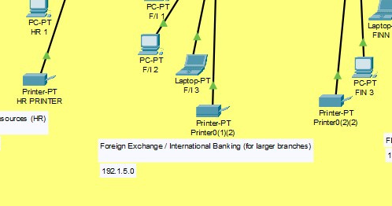
FLOOR 2 NETWORK OVERVIEW
Hosts the following departments:
Human Resources (HR)
Finance
Foreign Exchange / International Banking
Each department includes:
LAN-connected PCs and network printers
Connected through a Layer 2 switch for intra-department communication
All devices receive IP addresses via DHCP,
DHCP service is provided by the central DHCP server on Floor 4 (Server Room)
Server Access:
All departments access the main centralized database server hosted in the Server Room on Floor 4
Credential-based authentication is enforced for secure access to shared resources and database systems
Assigned subnets:
192.1.4.0/24 – Human Resources
192.1.5.0/24 – Finance
192.1.6.0/24 – Foreign Exchange / International Banking
Dynamic routing protocols are used to ensure efficient inter-departmental and enterprise-wide connectivity
Page | 03

Slide 8
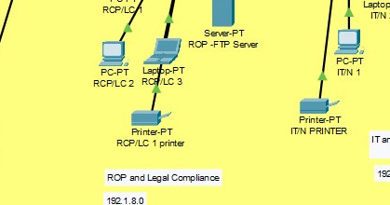
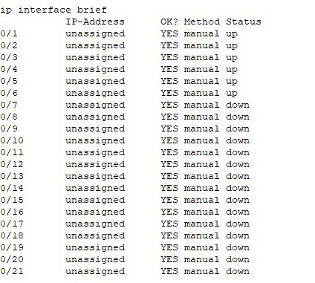
FLOOR 3 NETWORK OVERVIEW
Hosts the following departments:
ROP and Legal Compliance
IT and Network Administration
Each department includes:
LAN-connected PCs and network printers
Connected through a Layer 2 switch for intra-department communication
All devices receive IP addresses via DHCP,
DHCP service is provided by the central DHCP server located on Floor 4 (Server Room)
Server Access:
The ROP and Legal Compliance department hosts its own dedicated departmental server
IT and Network Administration departments manage and access core infrastructure services
Credential-based authentication is enforced to ensure secure access to systems and data
Assigned subnets:
192.1.7.0/24 – Reserved for additional or future use
192.1.8.0/24 – ROP and Legal Compliance
192.1.9.0/24 – IT Department
Dynamic routing protocols ensure efficient, scalable, and fault-tolerant communication across the enterprise network
Page | 03

Slide 9
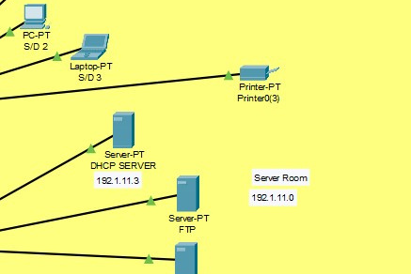
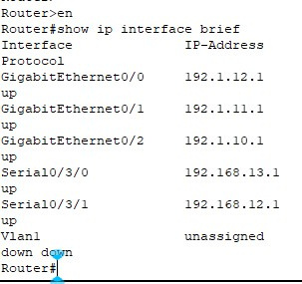
FLOOR 4 NETWORK OVERVIEW
Hosts the following critical areas:
Security Department
Server Room
Cybersecurity Operations Center (CSOC)
Each area includes:
LAN-connected workstations, monitoring systems, and secured servers
Connected through Layer 2 switches with strict access control policies
Server Room:
Houses the central DHCP server that assigns IPs to all client devices across the enterprise
Hosts centralized database servers, application servers, and backup systems
Static IP addressing is used for all devices on this floor to enhance network control and security
CSOC:
Has complete monitoring and administrative access to all departmental servers across all floors
Manages network security, threat detection, and incident response
Assigned subnets:
192.1.10.0/24 – CSOC
192.1.11.0/24 – Server Room
192.1.12.0/24 – Security Department
Recognized as the most secured floor of the enterprise network due to its centralized infrastructure, restricted access, and critical role in cybersecurity operations
Page | 03

